Slide 1

Multi-Threading
Presented By:
Nagendra B S

Slide 2
Index
Introduction
Life Cycle of Thread
Methods of Thread
Why Threads?
Creation of Thread
Merits of multithreading
Problems of multithreading
Synchronization

Slide 3
Introduction
Before introducing the thread concept, we were unable to run more than one task in parallel. It was a drawback, and to remove that drawback, Thread Concept was introduced.
A thread in Java is the path followed when executing a program. All Java programs have at least one thread known as the main thread. It is well known for independent Execution.
The Process of Executing Multiple threads simultaneously without dependency of other threads refers to multithreading.

Slide 4
Life Cycle Of Thread
Thread is a well known for independent execution, During the life cycle a thread can move from different States.
New State (Born)
Runnable State (Ready)
Running State(Execution)
Waiting State(Blocked)
Dead State(Exit)

Slide 5
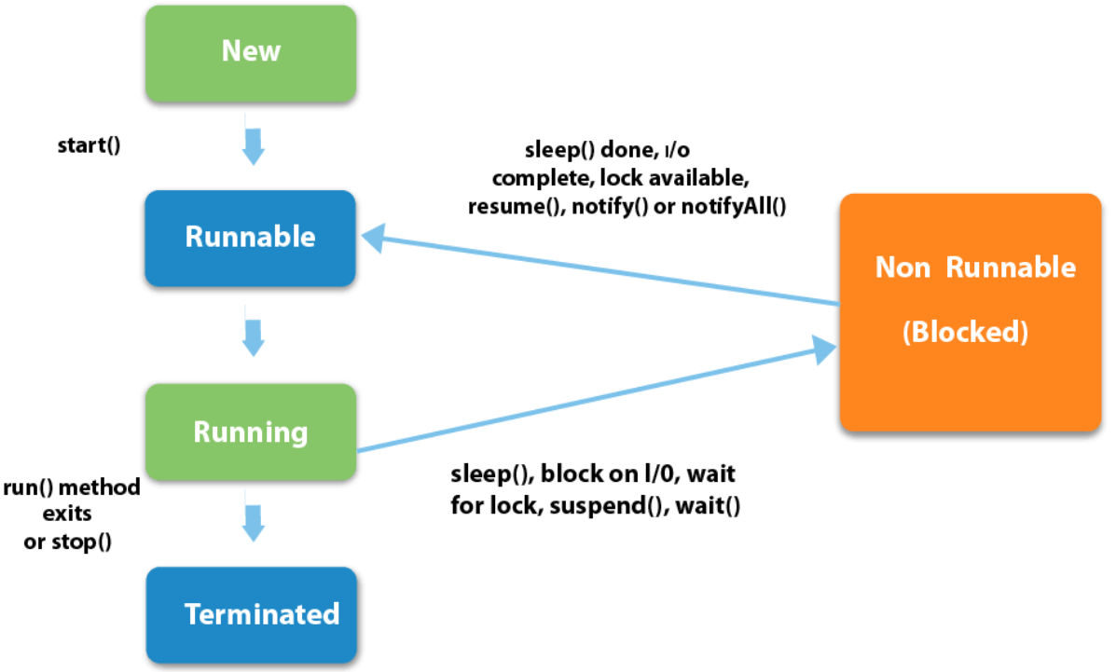
Life Cycle Of Thread

Slide 6
Methods Of Thread
public void run () : It triggers an action for the thread
public void start () : It initiates the execution of a thread
public void sleep () : It is used to suspend the thread temporarily
public void join () : It waits for a thread to die

Slide 7
Methods Of Thread
public void yield () : It is used to send the currently executing threads to standby mode and allow other threads to execute which have higher priority.
public void suspend () : It is used to instantly suspend the thread execution
public void resume () : It is used to resume the execution of a suspended thread only
public void stop () : It stop the execution of a thread

Slide 8
Why do we need threads?
To enhance parallel processing
To increase response to the user
To utilize the idle time of the CPU
Prioritize your work depending on priority

Slide 9
Creation Of Thread Class
By extending Thread class.
By implementing Runnable interface.
Significance between extending Thread class and implementing Runnable interface:
When we extend Thread class, we can’t extend any other class even we require.
When we implement Runnable, we can extends any other class , it saves space for our class to extend any other class in future or now.

Slide 10
Cont’d
By extending Thread class
class Test extends Thread
{
public void run()
{
System.out.println("Run method executed by child Thread");
}
public static void main(String[] args)
{
Test t = new Test();
t.start();
System.out.println("Main method executed by main thread");
}
}

Slide 11
Cont’d
Output:
Main method executed by main thread
Run method executed by child Thread

Slide 12
Cont’d
By implementing Runnable interface
public class A implements Runnable {
@Override
public void run() {
for (int i = 1; i <= 5; i++) {
System.out.println("Child Thread");
}
}
public static void main(String[] args) {
A r = new A();
Thread t = new Thread(r);
t.start();
for (int i = 1; i <= 5; i++) {
System.out.println("Main Thread");
}
}
}

Slide 13
Cont’d
Output:
Main Thread
Main Thread
Main Thread
Main Thread
Main Thread
Child Thread
Child Thread
Child Thread
Child Thread
Child Threada

Slide 14
Merits Of Multithreading
Responsiveness
Resource Sharing
Economy
Scalability
Utilization of multiprocessor architecture

Slide 15
Problem with Multithreading
Multithreading may provide some wrong results or some corrupted data in some situation, whenever an same resource is accessible by multiple thread at the same time.
Solution : Synchronization

Slide 16
Synchronization
Synchronization is a technique through which, we can control multiple threads or among the number of threads only one thread can enter into the synchronized area.
Synchronization is classified into two types:
Method level Synchronization
Block level Synchronization

Slide 17
Method level Synchronization
In method level synchronization thread will wait outside the method for access the resources, it will allow to access only one thread.
public synchronized void run()
{
// same resource
}
t1.start();
t2.start();
t3.start();

Slide 18
Block level Synchronization
In block level synchronization thread will wait outside the block for access the resources which is inside the method.
public void run(){
Synchronized(this){
// same resource
}
}
t1.start();
t2.start();
t3.start();

Slide 19
Conclusion
Multithreading in Java is an important concept that every Java developer should be aware of. It is very helpful in making the program efficient and reducing storage resource usage. It makes the CPUs be utilized optimally to perform well regardless of their complexity.

Slide 20
Thank You

